Slide 1
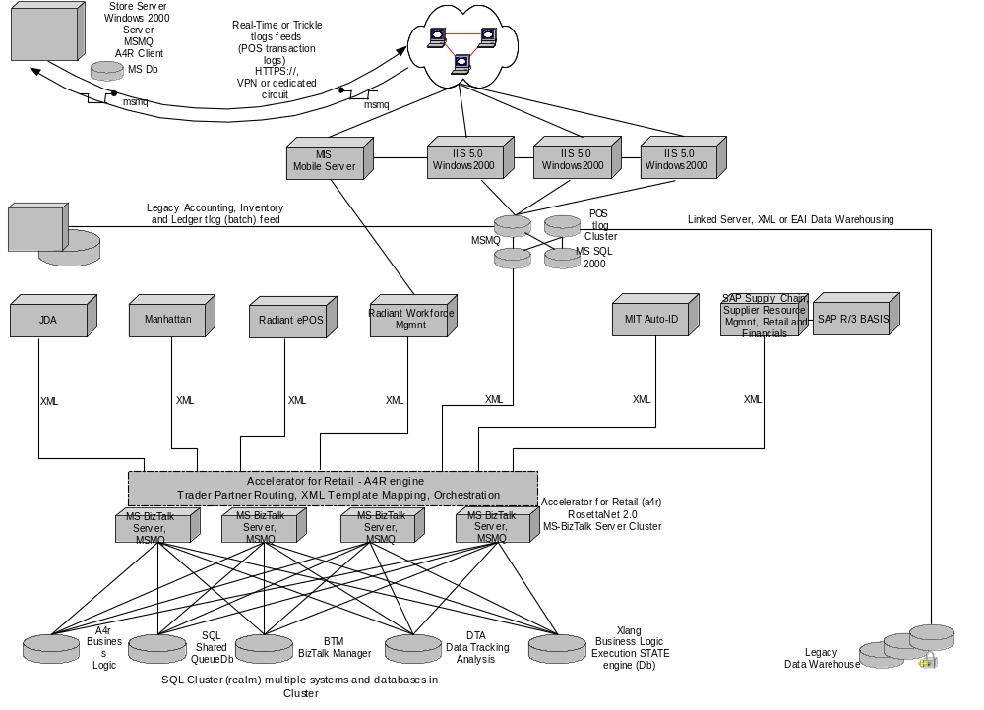
POS Sales transactions are transmitted to BT - A4R (BizTalk Accelerator for Retail) thru MSMQ in real time or trickled
A4R receives sales transactions from each store thru the POS adapter, parses t-log flat file into xml and loads the t-log SQL cluster
At predetermined intervals (15, 30, 60 minutes) the Item velocity monitor adapter pulls sales deltas from the t-log cluster and sends them into the IVM engine
The IVM engine generates alert messages and sends them back to the A4R through the inbound IVM alert templates
A4R forwards the message out of stock (OOS) alerts to the MIS Mobil Server for delivery
A4R calls the IVM Biztalk business rule for OOS conditionds, Beginning of day inventory is

